Slide 1
Speech Recognition with Matlab®
Neil E. Cotter
ECE Department
UNIVERSITY OF UTAH
necotter@ece.utah.edu

Slide 2
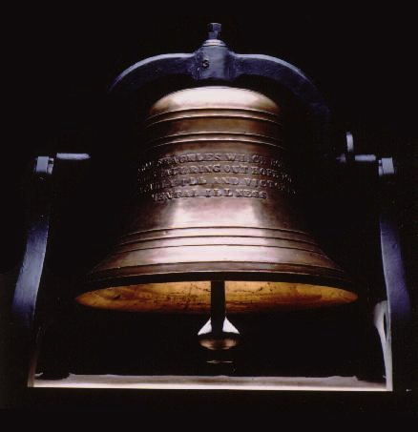
Resonances
[1]

Slide 3
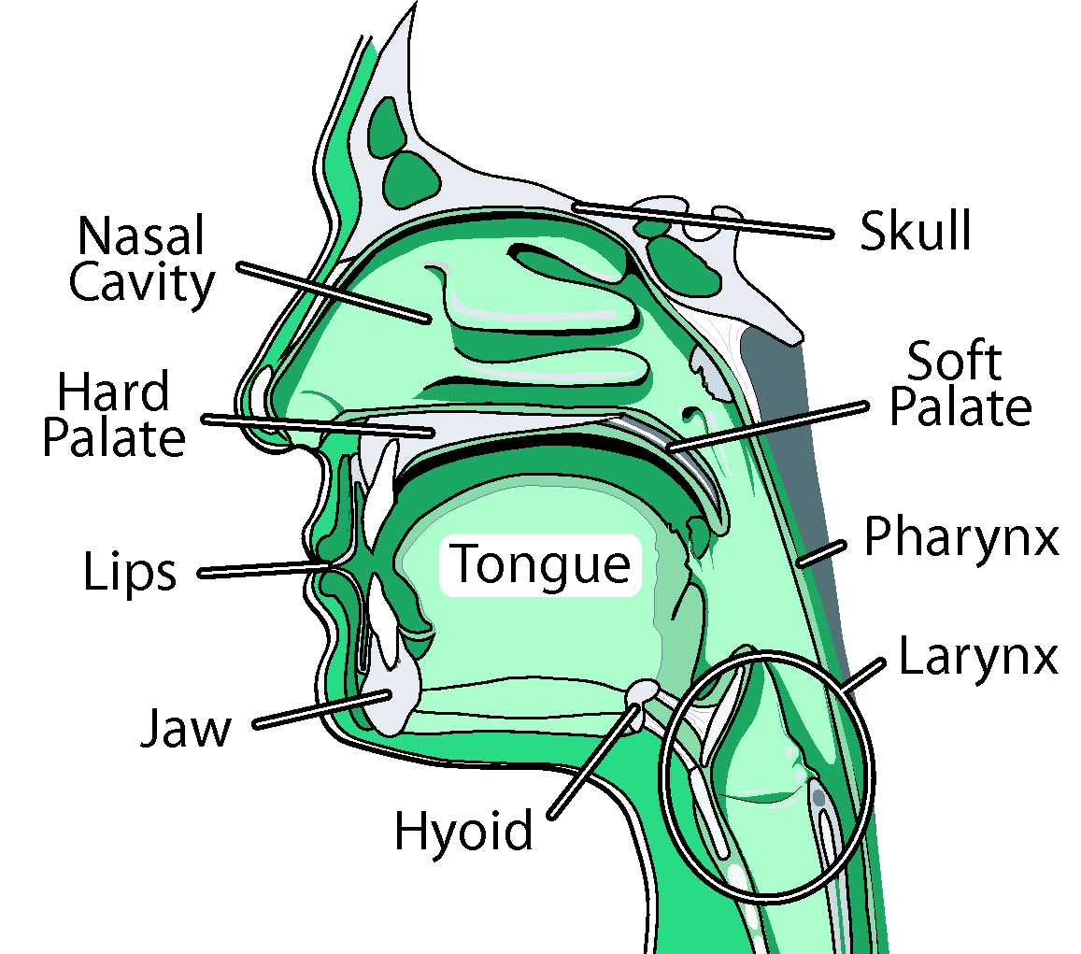
Vocal Tract
[2]
Pipe organ
Driven by puffs of air

Slide 4
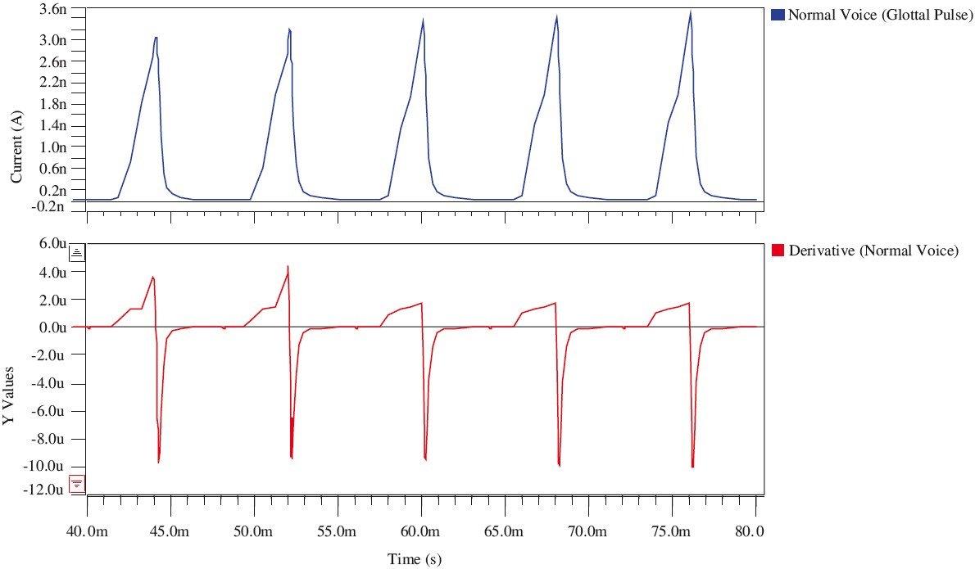
Glottal Pulses
[3]
Rate = voice pitch
Shape varies slightly

Slide 5
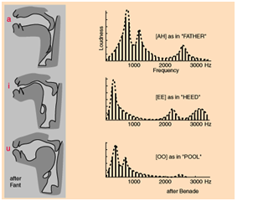
Formants
[4]
Frequency response
Vowel = musical chord

Slide 6
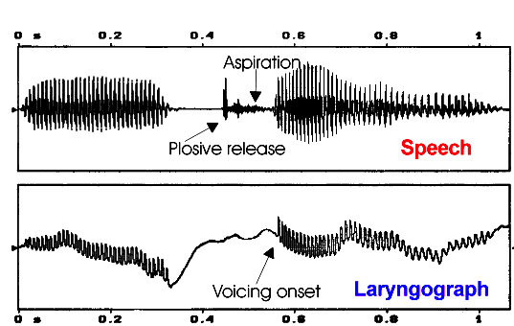
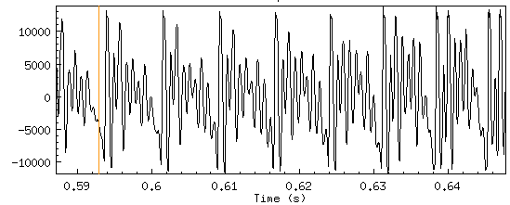
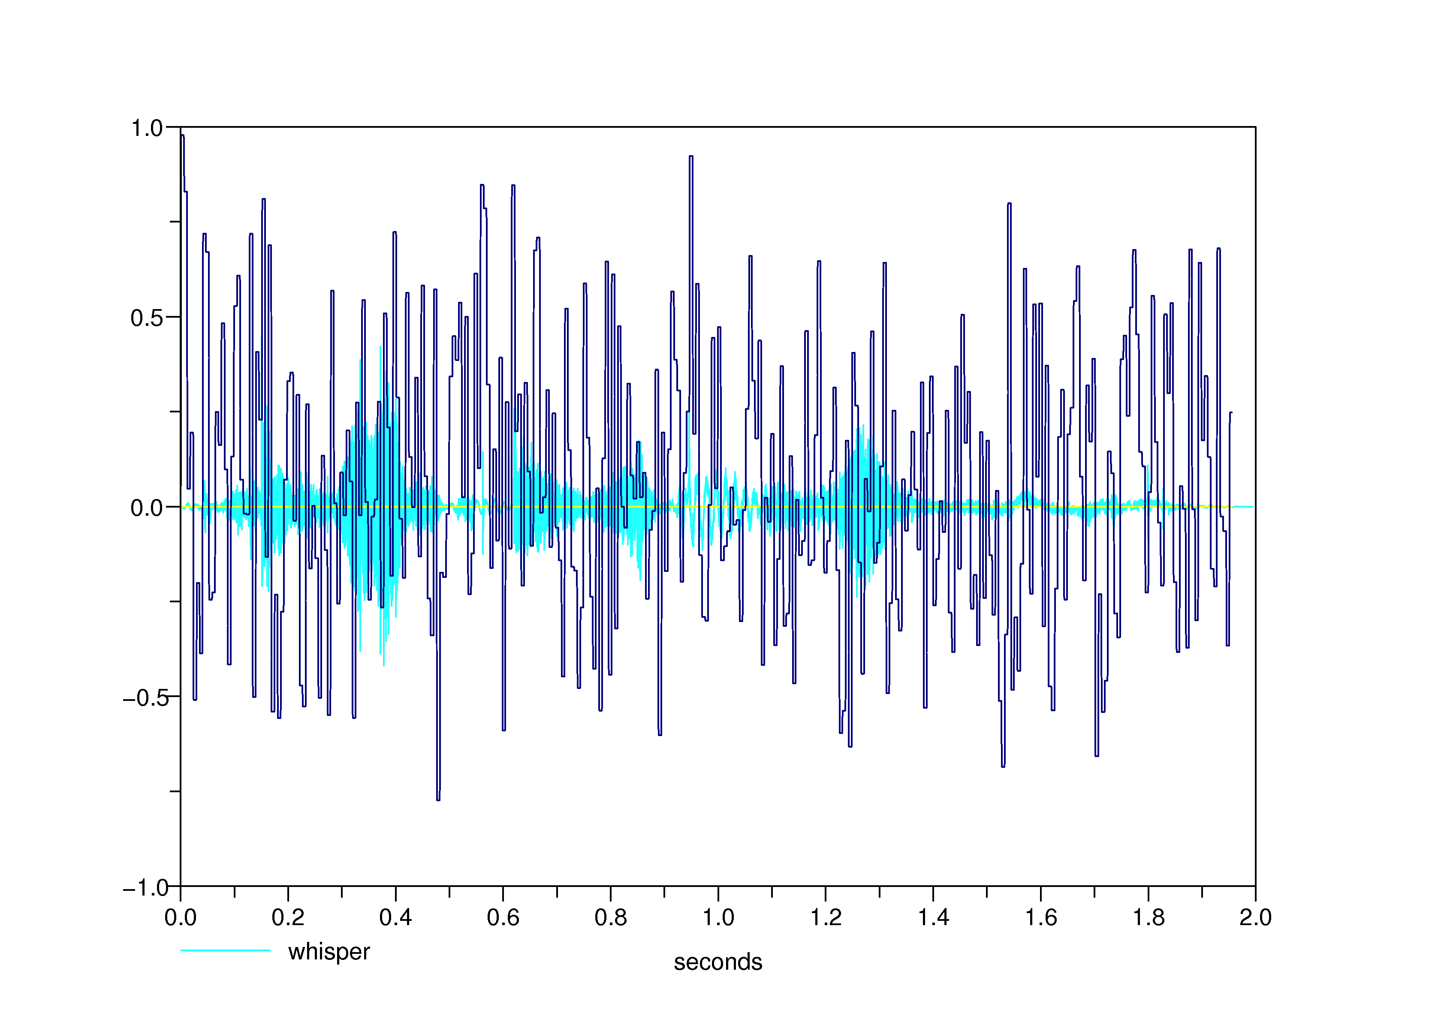
Speech Waveform
[5]
Vowel repetitive
[7]
Plosive explosive
[6]
Fricatives noisy

Slide 7
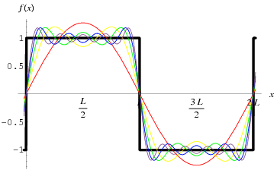
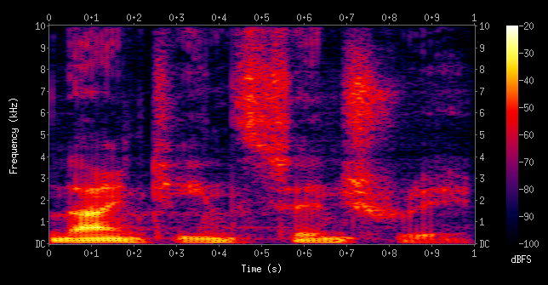
Fourier Theory
[8]
Waveform = Sum of Sinusoids
“Ninteenth Century”
[9]
Speech: FFT of short Frames

Slide 8
References
[1] http://www.nmha.org/go/bell
[2] http://www.vocalclinic.net/
[3] http://www.jr.ietejournals.org/article.asp?issn=0377-2063;year=2011;volume=57;issue=4;spage=363;epage=371;aulast=Raj
[4] http://people.ece.cornell.edu/land/courses/ece4760/FinalProjects/s2011/wd65_yz526/wd65 and yz526/highlevel.html
[5] http://web.science.mq.edu.au/~cassidy/comp449/html/comp449.html
[6] http://folk.uio.no/ristoh/aspiration/analysis.html
[7] http://www.phon.ucl.ac.uk/home/johnm/siphtra/plostut2/plostut2-5.htm
[8] http://mathworld.wolfram.com/FourierSeriesSquareWave.html
[9] https://kiwi.ecn.purdue.edu/rhea/index.php/Speech_Spectrogram
Neil E. Cotter
necotter@ece.utah.edu

