Slide 1
Dates to Know
ECE New Grad Orientation
Aug. 19th – First Day of School
Aug. 30th – Add/Drop Deadline (Pay Tuition!)
Sept. 2nd – Labor Day
Sept. TBA – ECE BBQ
Oct. 6-13th – Fall Break
Nov. 28-29th – Thanksgiving Break
Dec. 5th – Last day of classes
Dec. 9-13th – Final Exams
No classes,
campus offices closed
No classes,
campus offices closed

Slide 2
Virtual Campus Tour

Slide 3
ECE New Grad Orientation
Liz Rowberry Graduate Student Coordinator (All MS and PHD Advising) Liz.rowberry@utah.edu MEB 2266-C ECE Academic Advising Schedule an Appointment
John Bolke ECE Advising Coordinator (Tuition Benefits) John.bolke@utah.edu MEB 2262 ECE Main Office

Slide 5
Liz 2266-C
John 2262
ECE Academic Advising Center 2266 MEB

Slide 6
Tuition & Accounting Contact info
STuDENTS on Fellowships
Students in Industry
Matthew Plooster PARK 302 801-581-6020 fellowships@gradschool.utah.edu
Income Accounting Webpage 801-581-7344 income@utah.edu – when emailing, please include your name and UNID to speed up process

Slide 7
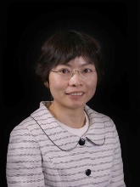
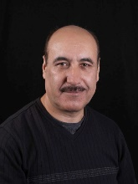
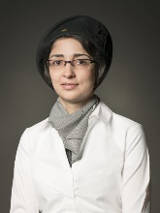
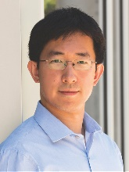
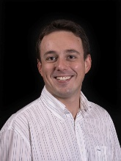
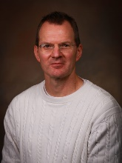
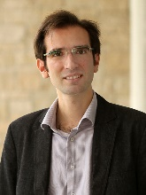
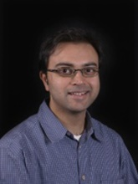
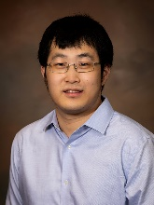
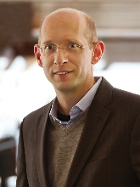
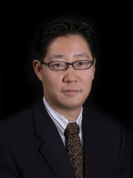
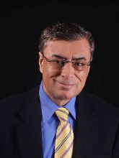
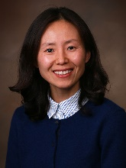
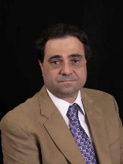
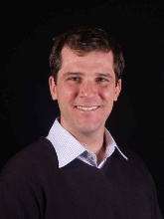
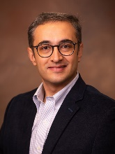
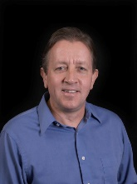
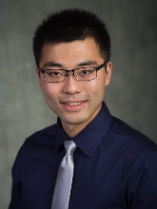
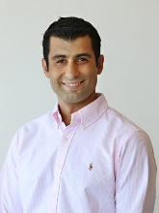
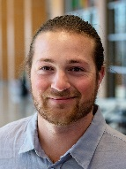
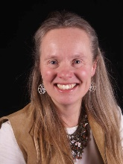
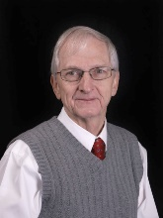
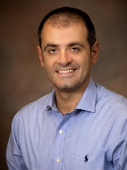
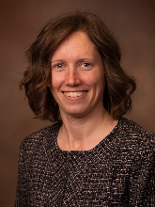
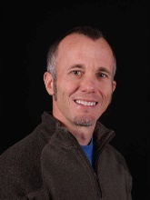
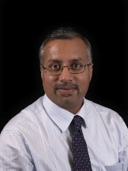
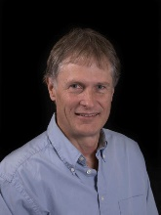
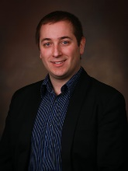
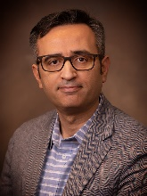
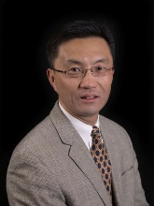
Research Areas and Faculty
Communications, Image Processing, AI and Signal Processing
Optics and Optoelectronics
Chen
Farhang
Nategh
Xiang
Tasdizen
Blair
Sensale-Rodriguez
Menon
Gao
Electronics and MEMS
Power, Control, and Robotics
Solzbacher
Kim
Tabib-Azar
Yoon
Mastrangelo
Scarpulla
Parvania
Bodson
Liu
Sahraei-Ardakani
George
Electromagnetics (Fields and Waves)
Electronic Circuits and Systems
Kalla
Stevens
Gaillardon
Furse
Christensen
Sanchez
Simpson
Schurig
Computer Engineering, AI, & VLSI Design
Tajalli
Young

Slide 8
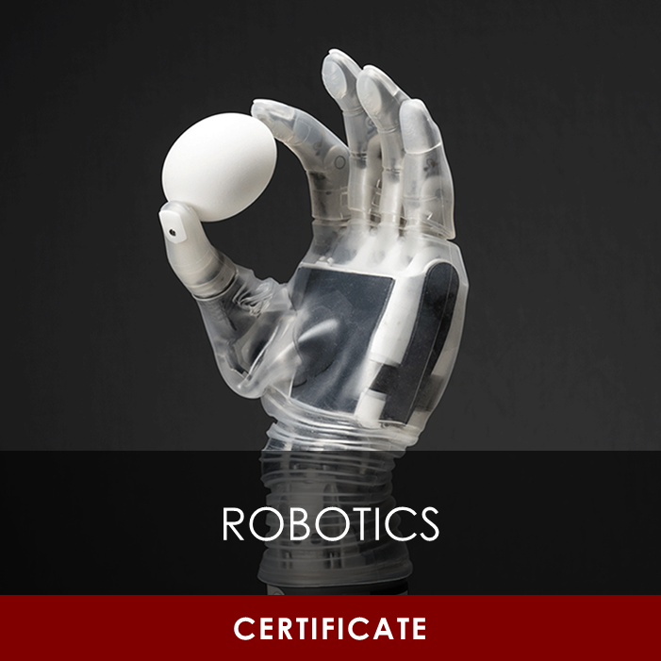
Areas of Emphasis & Certification

Slide 9
New Student Steps
All Students
Employed Students
Register for classes
Permission Code Requests
Submit Transcripts
Submit Immunizations
Activate UCard – Mobile ID
International Students: Attend ISSS Orientation, Aug. 13, 14, or 15th
More info in
TB presentation
after lunch
Get on Payroll
International Students: Get a SSN
Request key access from Lucinda (ECE Main Office) to get into research labs

Slide 10
Graduate Program Overview

Slide 11
Graduate Supervisory Committee
Approves a student’s research / coursework and will guide the student to make sure that their studies are sufficiently rigorous and appropriate for a graduate degree.
MS Committee
PhD Committee
Committee Chair
Faculty Advisor for Project/Thesis
Committee Chair
Faculty Advisor/PI
1 member from outside ECE dept
Most MS students will be assigned a default committee based on their area of emphasis
Most PhD students don’t need to form a committee until their 3rd semester for their QE (Qualifying Exam)

Slide 12
PhD Degree Pathways
Milestone MS
Transfer MS
PhD Only
Earn an ECE MS degree on the way to your PhD (Students who have not earned an MS degree are required to complete this)
For students who have already earned an MS degree from an outside university or institution.
For students who have already earned a MS degree from the University of Utah.

Slide 13
MS Program of Study Requirements
Also applies to PhD students earning Milestone MS!

Slide 14
Types of MS Programs
Coursework
Project
Thesis
Great for students who prefer the predictable flow of courses but are not interested in taking responsibility and managing additional research or projects.
Great for students who want to do research (on-campus or in industry) without the scope and of an entire thesis.
(10-pg write-up vs 50+ pg thesis)
Great for students who are debating about doing a PhD and/or have a funding faculty member they are interested in doing research with.

Slide 15
MS Degree Requirements
Track | Electrical Engineering | Computer Engineering
Required Courses | ECE 6900 Graduate Seminar I (Fall) ECE 6910 Graduate Seminar II (Spring) | ECE 6710 Digital VLSI Design ECE 6810 Computer Architecture 2-4 Restricted Elective List courses
Criteria | 3.0 GPA on courses listed on Program of Study, no grade lower than C- 18+ of those must be ECE 6000-7000 level courses Up to 12 hours of Allied courses accepted (Graduate Seminar counted as Allied) Final Exam Course Requirement Fulfilled
PhD Degree Requirements
 | Milestone MS | Transfer MS | PhD Only
Required Courses | ECE 7951 Teaching Mentorship 14+ hours of research ECE 7900 & 7910 Graduate Seminar (only for EE Students)
Additional Pathway Reqs. | Milestone MS Requirements | Additional U of U Coursework 12+ hours for EE OR 7+ hours for CE | Not required

Slide 16
Resources

Slide 17
Academic
Library
Equipment Checkout (i.e. laptops)
Family Reading Room
Graduate Reading Room
Protospace
3D Printers, sewing machines, podcast booths, graphic tablets, etc.
Writing Support
ECE Graduate Writing Resources & Templates
GREW Center - Graduate Research Engineering Writing
Writing Center eTutoring
Grammarly Premium
Check your UMail Regularly
ECE Graduate Newsletter

Slide 18
Financial & Career
Financial Wellness Center
Free and confidential consultation with an accredited financial counselor.
Basic Needs Collective
Find resources for affordable housing, childcare, food, insurance, legal services, and more.
UCareer Success
Free resume help and professional headshots
Interview Rooms w/ video setup
Career Closet – free business clothes
Register to attend Career Fairs
Aug. 28th: Engineering Club Rush
Sept 24th: Campus-Wide Internship & Career Fair
**Oct 1st: STEM Internship & Career Fair**
International: Talk to Liz about CPT/OPT possibilities (you can qualify after your 2nd semester on campus!)

Slide 19
Social, Mental, and Physical Health
Please let us know if you need support!
Withdrawal Deadline Oct. 18th
Request Leave of Absence by add/drop deadline
University Counseling Center
College of Engineering Counseling Services
Center for Student Wellness
Student Parent Support Center
IEEE
Grad SAC (Student Advisory Council)
Tau Beta Pi
Society of Women Engineers
UCubeSat
International Clubs and Associations
Arab Student Association
Bangladeshi Student Association
Indian Student Association
Korean Student Association
Pakistan Student Association
Persian Student Association
Saudi Student Association
Thai Student Association

Slide 20
Other Student Benefits
Student Discounts
(With student ID APP) free access to:
Red Butte Gardens
Natural History Museum (Dinosaurs + More!)
Utah Museum of Fine Arts
Pioneer Theatre Company
Software Access (Adobe Suite, Microsoft Office, + more!)
UTA Bus, TRAX, and Frontrunner transportation
Free digital subscriptions to:
The New York Times
Wall Street Journal
Student pricing on IKON ski passes
Discounted Utah Symphony & Opera tickets
Most Useful Student Discounts in 2021
Shopping Student Discounts
Older Student Discounts that may or may not still be available (2017)

Slide 21
Q & A

Slide 22
Tuition Benefit Information & Requirements (TBP)
john.bolke@utah.edu
For students currently employed as Teaching or Research Assistants

Slide 23
STEPS To Get on Payroll
Students With SSN
Students Without SSN
Complete the Personnel Information form
Schedule appointment with Bob (Robert.Knudsen@utah.edu) and bring:
Domestic students:
I-9 Required Documentation
International students:
Passport
I-94
I-20 (signed by ISSS office)
Social Security Card
Upload signed offer letter form to UAtlas
Visit ISSS during walk-in hours to get offer letter form and I-20 signed
Go to Social Security Office and get a Social Security receipt!
Schedule appointment with Bob (Robert.Knudsen@utah.edu) and bring:
Passport
I-94
Signed I-20
Social Security application receipt
Visa

Slide 24
Start Tuition Benefit Process
2. Complete Tuition Benefit form before Aug. 26th
3. In CIS – sign Tuition Benefit Document by Aug. 28th
Tuition Benefit will show on student tuition account by Aug. 29th
Tuition will be reduced the next day by midnight
4. Tuition is due on Friday, August 30th @ 4:45 PM
Will be emailed to your UMail soon!
1. You must be on payroll as a RA or TA
Once completed, information will be entered by ECE department into system

Slide 25
Semester Pay Information
ASSISTANTSHIP PAYROLL INFORMATION
PAY DAY: 7th and 22nd of every month
SEMESTER PAY PERIODS
Fall | August 16 - December 31 (9 pay periods)
Spring | January 1 - May 15 (9 pay periods)
Summer | May 16 - August 15 (6 pay periods)
Funding needs to be disbursed through ECE Administration

Slide 26
Tuition Benefit Support
SEMESTER | 100% BENEFIT
Fall 2024 | $10,000
Spring 2025 | $10,000
Summer 2024 | $6,670

Slide 27
Tuition Benefit Requirements and limits
Students must earn 100% tuition benefit support
Students must be enrolled in minimum requirements
Students must maintain a 3.0+ GPA to be eligible for Tuition Benefits
Semester | CREDIT HOURS
Fall/Spring | 9 – 12.0 coursework/research OR 9.0 research only*
Summer (not required) | 3.0 research only
*Suggested at this time: All PhDs should be enrolled in a minimum of 9 credits. After proposal exam, students can reduce to only 3 credits of research and remain classified as full-time (including international students)

Slide 28
TBP DOES NOT COVER
Differential Tuition (For TA’s)
Outside Mandatory Fees: Books, Course Fees, Lab Fees, etc.
Repeat Courses
Withdrawn Courses
International Surcharge

Slide 29
Health Insurance
Health Insurance - Select Yes or No Tuition Benefit Form
100% covered if on Tuition Benefit
Receive email instructions to set-up and use United Health Insurance once enrolled

Slide 30
Graduate Subsidized Health Insurance Program (GSHIP)
United Health Care
https://www.uhcsr.com/school-year
EMI Health
HTTPS://EMIHEALTH.COM/
Additional health benefits such as:
Dental
Eyeglass Insurance

Slide 31
ISSS International Requirements
ISSS Orientation https://isss.utah.edu/
Work authorization
I-20 Compliance
9 credit hours per semester
I-20 extension
CPT/OPT https://isss.utah.edu/workshops.php

Slide 32
Contact
Liz Rowberry Graduate Student Coordinator (All MS and PHD Advising) Liz.rowberry@utah.edu MEB 2266-C ECE Academic Advising
John Bolke ECE Advising Coordinator (Tuition Benefits) John.bolke@utah.edu MEB 2262 Next to the advising suite

Slide 33
Q & A

