Slide 1
Electrical & Computer Engineering How to graduate.
By John Bolke and Liz Rowberry.

Slide 2
Social Media
ECE Graduate Newsletter
Instagram – Instagram.com/uofuece
Facebook – facebook.com/UofUECE
Twitter – x.com/UofUECE

Slide 3
MS Possible Tracks
Computer Engineering
Electrical Engineering
Description on ECE Website:
https://www.ece.utah.edu/graduate-programs-in-ece/ms-degree/
https://www.ece.utah.edu/graduate-course-offerings/

Slide 4
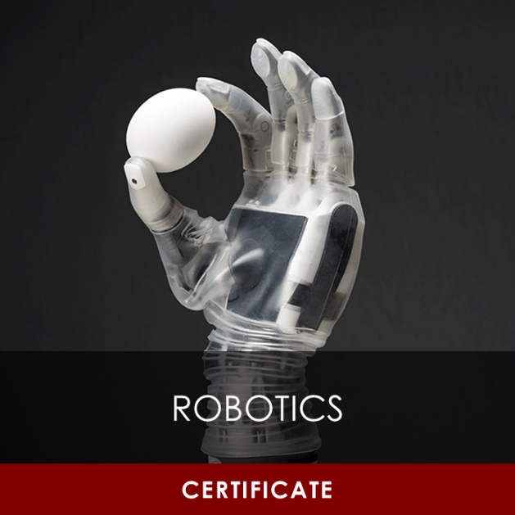
Certificates

Slide 5
MS Degree Requirements
(this includes Milestone MS for PhD)
Track | Electrical Engineering | Computer Engineering
Required Courses | ECE 6900 Graduate Seminar I (Fall) ECE 6910 Graduate Seminar II (Spring) | ECE 6710 Digital VLSI Design ECE 6810 Computer Architecture 2-4 Restricted Elective List courses
Criteria | 3.0 GPA on courses listed on Program of Study, no grade lower than C- 18+ of those must be ECE 6000-7000 level courses Up to 12 hours of Allied courses accepted (Graduate Seminar counted as Allied) Final Exam Course Requirement Fulfilled

Slide 6
MS Program Final Exam Options
COURSEWORK
PROJECT
Thesis
Students complete a course from the approved Final Exam List with a B or higher.
3-6 Credits ECE 6950
Students complete a final write-up or presentation on project (at project advisor’s discretion)
6-10 Credits ECE 6950/6970
Students start Project option
After all 6 credits are completed, assess work with advisor
If advisor approves their work, they may convert project to thesis
Proposal/defense cannot be done the same semester

Slide 7
Final Exam/Report for the M.S. degree
Thesis Option
ECE 6970 (10 CR) for thesis hours
Final (public) thesis defense
For EE, up to 3-page thesis proposal/possible presentation by 3rd semester, and then thesis defense
For CE, thesis proposal (no more than 10 pages) + presentation by 3rd semester, and then thesis defense
Both cannot be scheduled in the same semester.

Slide 8
Supervisory Committee
Coursework: Default from your focus area
Project: Professor(s) supervising ECE 6950
Thesis: Professor supervising your thesis research (ECE 6970/7970)
Need two more committee members
One member can be from outside department

Slide 9
Graduate Supervisory Committee
Approves a student’s research / coursework and will guide the student to make sure that their studies are sufficiently rigorous and appropriate for a graduate degree.
MS Committee
PhD Committee
Committee Chair
Faculty Advisor for Project/Thesis
Committee Chair
Faculty Advisor/PI
1 member from outside ECE dept
Most MS students will be assigned a default committee based on their area of emphasis
Most PhD students don’t need to form a committee until their 3rd semester for their QE (Qualifying Exam)

Slide 10
Program of Study Plan
List of courses you plan to take, and which semester
ECE Department + Grad School requirements
May consult with your faculty advisor

Slide 11
Process to graduate Degree
Fall 2024
Enroll in ECE 6900 Grad Seminar
Complete REd Trainings and Modules
Spring 2025
Enroll in ECE 6910
Semester you will complete 30 credit hour, apply to graduate by deadline (add/drop deadline)

Slide 12
Academic
Library
Equipment Checkout (i.e. laptops)
Family Reading Room
Graduate Reading Room
Protospace
3D Printers, sewing machines, podcast booths, graphic tablets, etc.
Writing Support
ECE Graduate Writing Resources & Templates
GREW Center - Graduate Research Engineering Writing
Writing Center eTutoring
Grammarly Premium
Check your UMail Regularly
ECE Graduate Newsletter

Slide 13
Financial & Career
Financial Wellness Center
Free and confidential consultation with an accredited financial counselor.
Basic Needs Collective
Find resources for affordable housing, childcare, food, insurance, legal services, and more.
UCareer Success
Free resume help and professional headshots
Interview Rooms w/ video setup
Career Closet – free business clothes
Register to attend Career Fairs
Aug. 28th: Engineering Club Rush
Sept 24th: Campus-Wide Internship & Career Fair
**Oct 1st: STEM Internship & Career Fair**

Slide 14
Social, Mental, and Physical Health
IEEE
Grad SAC (Student Advisory Council)
Tau Beta Pi
Society of Women Engineers
UCubeSat
International Clubs and Associations
Arab Student Association
Bangladeshi Student Association
Indian Student Association
Korean Student Association
Please let us know if you need support!
Withdrawal Deadline Oct. 18th
Request Leave of Absence by add/drop deadline
University Counseling Center
College of Engineering Counseling Services
Center for Student Wellness
Student Parent Support Center
Pakistan Student Association
Persian Student Association
Saudi Student Association
Thai Student Association

