Slide 1
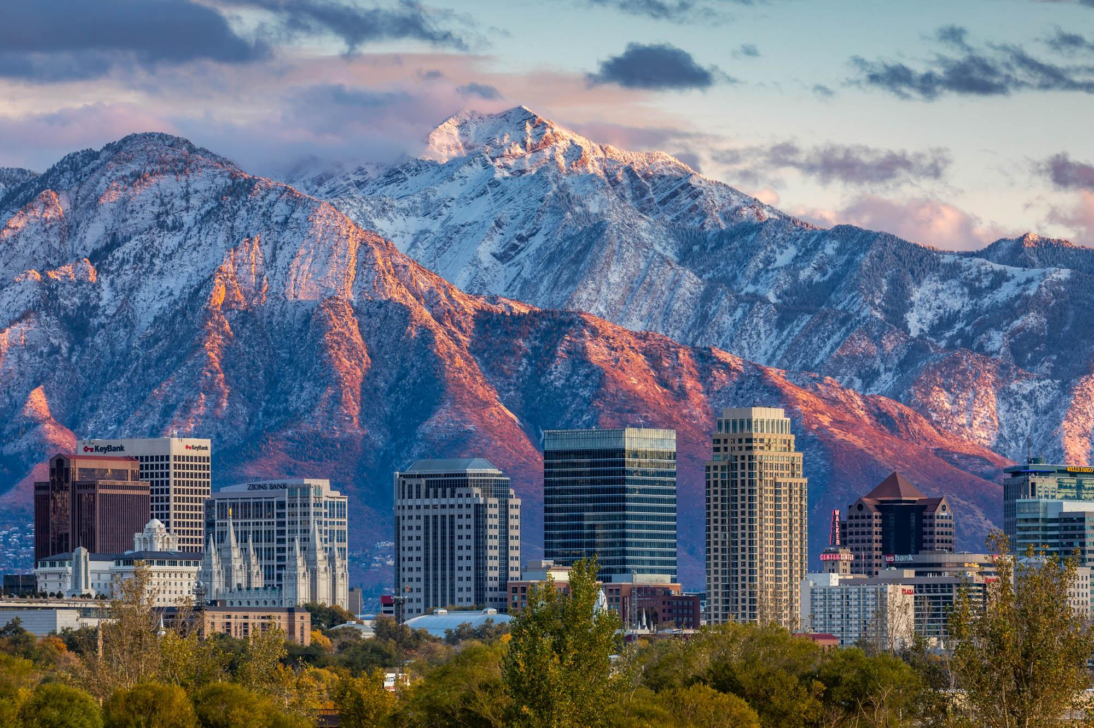
Welcome to
Salt Lake City!
Jakob Travis, Philip Johnson
Jan 2025!

Slide 2
Why are we doing this?
SLC and U of U!
Resources!
Fun!
…because this is some more info we wish we knew when we got here…
Being a student is much more than simply academics.
Quick, cool history
What to know, funky rules and more!
What’s free and at your disposal as a student?
What are the best ways to get around town?
Top things to do and how to do them!
Bars, restaurants, games, clubs, etc.
How to get involved in the community?
Notes:
Jacuzzi at SLO,

Slide 3
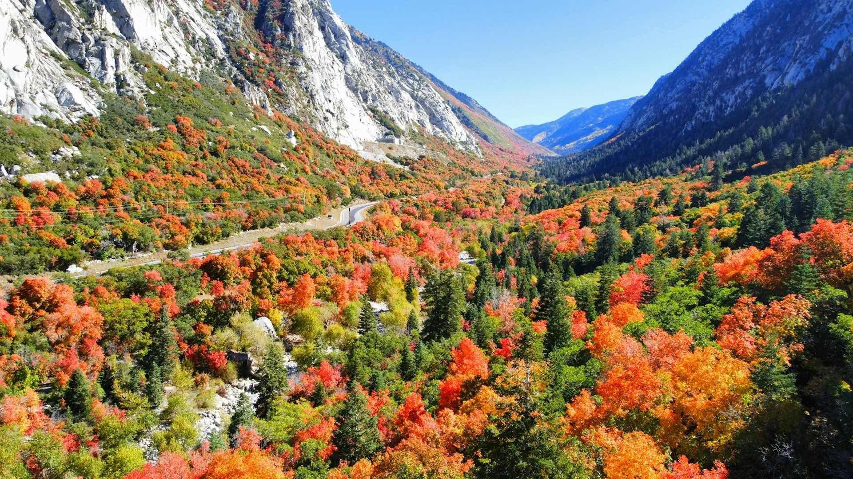
SLC and U of U
Little Cottonwood Canyon

Slide 4
History of Salt Lake City
Originally inhabited by the Shoshone and Ute Native American Tribes
City founded 1847 by Mormon Pioneers (Pioneer Day July 24th)
1850 became a US state - 1850 U of U established
Hosted 2002 Winter Olympics and is set to host 2034 Winter Olympics
Budding LGTBQ+ population and community
Notes:
Philip

Slide 5
Best Things about SLC
Outdoor adventures and activities!
Fun bar scene and young population
Industry Growth in Engineering (Silicon Slopes)
Inclusive community and city clubs
Accessibility to Downtown, other subsections of city

Slide 6
Strange Rules and Fun Facts
Liquor Laws - 5% ABV sold at grocery stores, anything else at a state liquor store
Housing Laws - cannot rent a home with more than 4 bedrooms unless you are directly related
Largest Costco in the world! Would avoid going Sat. morning, Sun. afternoons
Utah’s State Bird is the California gull (seagull)
High School Musical was filmed at East High (down 1300 S from campus)
Notes:
Philip

Slide 7
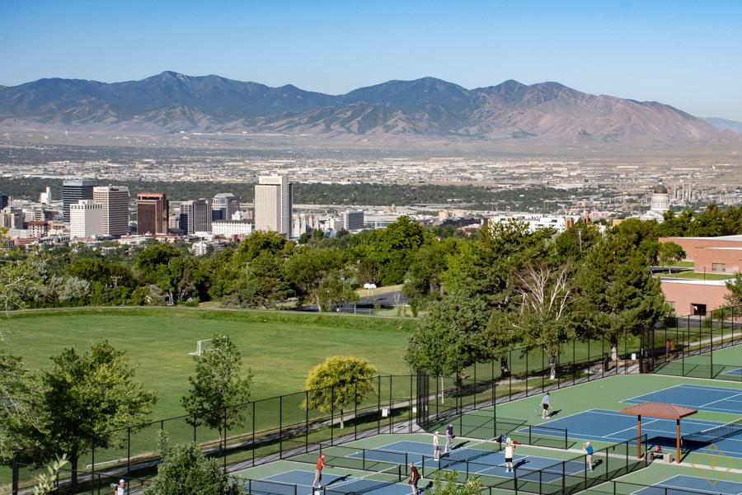
Resources
11th Ave Park

Slide 8
Food, Survival, Essentials
U of U Food bank - Feed U Pantry
Farmer’s Markets - every weekend in downtown and Sugarhouse
Applying for SNAP - federal food stamps - circumstantial
Free Rentable Technology at Library
Rentable Conference / Podcast / Study Rooms available online
Notes:
Philip

Slide 9
Transportation
UTA Transit System
FREE!
All buses UTA buses and trains. Just scan your UID.
Download the TRANSIT APP - most reliable updated bus and train timers.
Red Line
Train
Most accessible train for campus…takes you all the way up to top of campus / hospital.
UTA Bus
Bus
Common lines to campus… Line 1, Line 2 from Downtown. Line 9 from Liberty Park. Line 21 from Sugarhouse
University Bus
Bus
Can take you all over campus.

Slide 10
Discounts and Free
Free entrance to National History Museum of Utah, Red Butte Gardens, Pioneer Theatre Company
KSL Classifieds - Craigslist for Utah
10% Off Pie Pizzeria!
Spotify/Apple Music for $5 a month - Amazon Prime 6 months FREE
% off if you are an employee of the University @ Campus Stores
Notes:
Philip

Slide 11
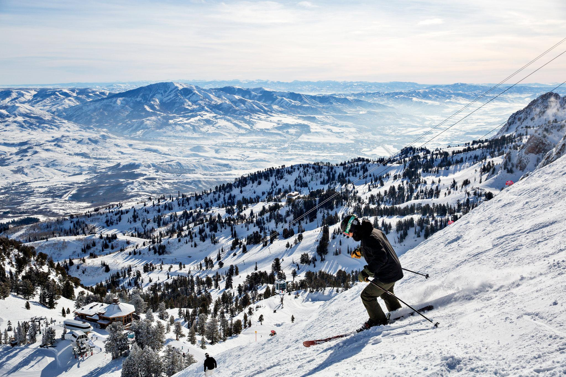
Fun and Entertainment
This could be you!
Snowbird Resort

Slide 12
Fun & Recreation @ the U
Crimson Night - The Biggest Party in Campus
Equipment Rentals @ the Student Life Center
600+ Clubs and Organisations
Intramural Sports and Activity Classes
Camping & Backpacking Adventures organised by the Student Life Center
Notes:
Philip

Slide 13
Fun Amongst The City
999 Ride
Best Restaurants: Vessel Kitchen, The Pi Pizzeria, Millie’s Burgers
Best Budget Bars: Quarters (arcade), Green Pig, Blue Gene’s, TF Brewing
Best Activities: Museums, Skiing, Mountain Biking, Hiking, Theatre, Fishing, Movie Tuesdays ($5 Movies)
Bus to Park City - Sundance Film Festival, Winter Activities, Mountain Biking

Slide 14
Communities
Running and Social: Salty Star Run Club
The MUSS - Free tickets to games
Skiing: One Love
Events organised for International Students by ISSS
EACH OTHER! + GSAC

Slide 15
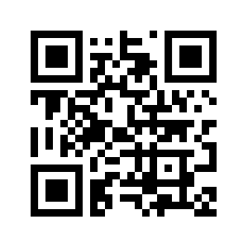
With Our Discord…

Slide 16
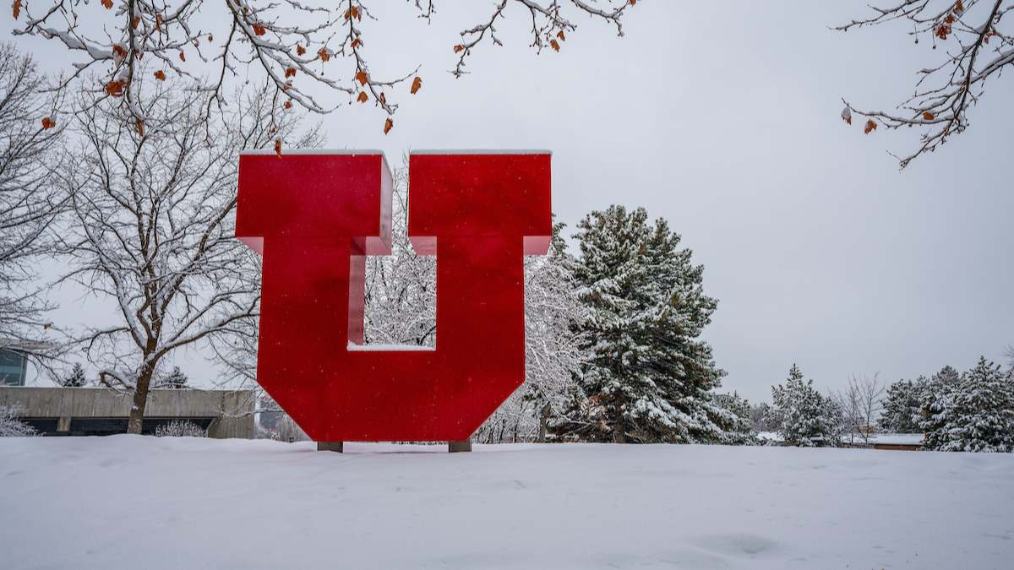
Welcome to Salt Lake City
Go Utes!!!
Questions?

