Slide 1
Virtual Campus Tour

Slide 2
Dates to Know
ECE New Grad Orientation
Jan. 6 – First Day of School
Jan. 17 – Add/Drop Deadline (Pay Tuition!)
Jan. 20 – MLK Day
Feb. 17 – President’s Day
Feb. 28 – Withdrawal Deadline
March 9-16 – Spring Break
April 22 – Last day of classes
April 24-30 – Final Exams
No classes,
campus offices CLOSED
No classes,
campus offices OPEN

Slide 3
ECE New Grad Orientation
Liz Rowberry Graduate Student Coordinator (All MS and PHD Advising) Liz.rowberry@utah.edu MEB 2266-B ECE Academic Advising Schedule an Appointment
John Bolke ECE Advising Coordinator (Tuition Benefits) John.bolke@utah.edu MEB 2262 ECE Main Office

Slide 5
Stockroom 2355
Liz 2266-B
John 2262
ECE Academic Advising Center 2266 MEB

Slide 6
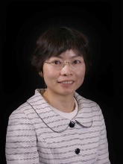
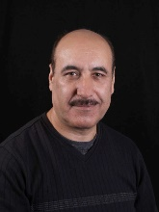
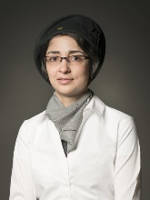
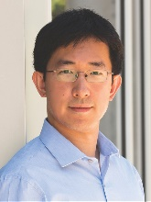
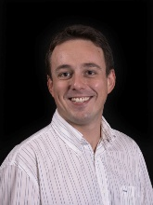
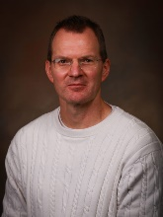
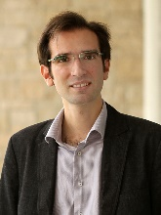
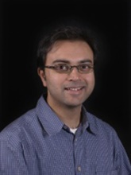
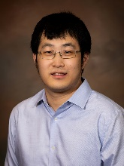
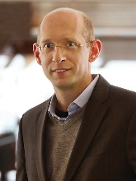
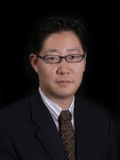
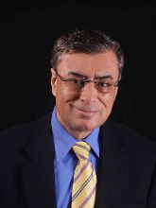
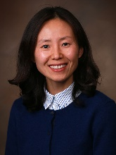
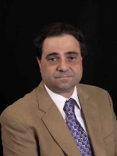
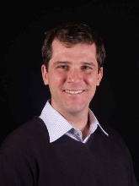
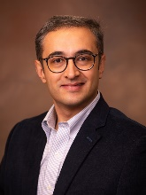
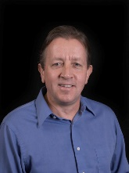
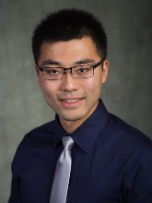
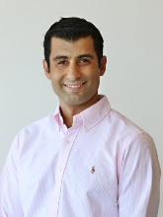
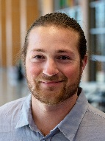
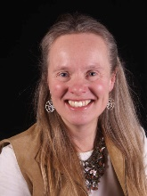
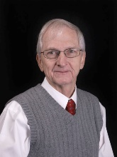
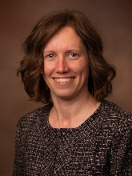
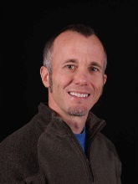
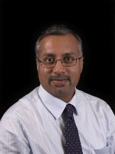
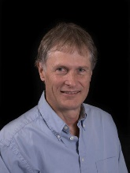
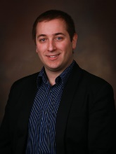
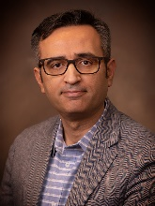
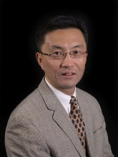
Research Areas and Faculty
Communications, Image Processing, AI and Signal Processing
Optics and Optoelectronics
Chen
Farhang
Nategh
Xiang
Tasdizen
Blair
Sensale-Rodriguez
Menon
Gao
Electronics and MEMS
Power, Control, and Robotics
Solzbacher
Kim
Tabib-Azar
Yoon
Mastrangelo
Scarpulla
Parvania
Bodson
Liu
Sahraei-Ardakani
George
Electromagnetics (Fields and Waves)
Electronic Circuits and Systems
Kalla
Stevens
Gaillardon
Furse
Christensen
Simpson
Schurig
Computer Engineering, AI, & VLSI Design
Tajalli
Young

Slide 7
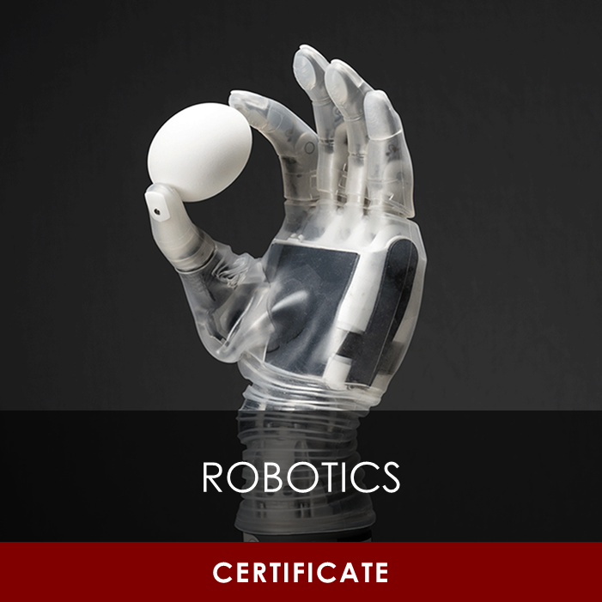
Areas of Emphasis & Certification

Slide 8
New Student Steps
All Students
Employed Students
Register for classes
Permission Code Requests
Submit Transcripts
Submit Immunizations
Activate UCard – Mobile ID
International Students: Attend ISSS Orientation, Jan 3rd
Get on Payroll
International Students: Get a SSN
Request key access from Lucinda (ECE Main Office) to get into research labs

Slide 9
Tuition & Accounting Contact info
Students Employed by the University - Payroll Info & FAQ
Students Employed by Industry - Students in Industry
Answers questions such as:
How do I get on payroll?
What tuition an fees am I responsible for?
How do I get enrolled in health insurance and get coverage for dependents?
And more!
Income Accounting Webpage 801-581-7344 income@utah.edu – when emailing, please include your name and UNID to speed up process

Slide 10
STAY CONNECTED
UMail – ECE Grad Student Newsletter
instagram.com/uofuece
discord.gg/TMjhuDCCfy

Slide 11
Resources

Slide 12
Academic
Library
Equipment Checkout (i.e. laptops)
Family Reading Room
Graduate Reading Room
Protospace
3D Printers, sewing machines, podcast booths, graphic tablets, etc.
Writing Support
ECE Graduate Writing Resources & Templates
GREW Center - Graduate Research Engineering Writing
Writing Center eTutoring
Grammarly Premium
Check your UMail Regularly
ECE Graduate Newsletter

Slide 13
Financial & Career
Financial Wellness Center
Free and confidential consultation with an accredited financial counselor.
Basic Needs Collective
Find resources for affordable housing, childcare, food, insurance, legal services, and more.
UCareer Success
Free resume help and professional headshots
Interview Rooms w/ video setup
Career Closet – free business clothes
Register to attend Career Fairs
Jan 21st: STEM Internship & Career Fair
International: Talk to Liz about CPT/OPT possibilities (you can qualify after your 2nd semester on campus!)

Slide 14
Social, Mental, and Physical Health
Please let us know if you need support!
Withdrawal Deadline Feb. 28th
Request Leave of Absence by add/drop deadline
University Counseling Center
College of Engineering Counseling Services
Center for Student Wellness
Student Parent Support Center
IEEE
GSAC (Grad Student Advisory Council)
Tau Beta Pi – Fellowship opportunities!
TEK Club
Society of Women Engineers
UCubeSat
International Clubs and Associations
Arab Student Association
Bangladeshi Student Association
Indian Student Association
Korean Student Association
Pakistan Student Association
Persian Student Association
Saudi Student Association
Thai Student Association

Slide 15
Other Student Benefits (W/ Student ID APP)
Student Discounts
free access to:
Red Butte Gardens
Natural History Museum (Dinosaurs + More!)
Utah Museum of Fine Arts
Software Access (Adobe Suite, Microsoft Office, + more!)
UTA Bus, TRAX, and Frontrunner transportation
Tickets:
Pioneer Theatre Company
One free ticket and up to three guest tickets for all men’s and women’s home basketball games.
Digital subscriptions to:
The New York Times
Wall Street Journal
Student pricing on IKON ski passes
Discounted rental equipment from Outdoor Adventures
Discounted Utah Symphony & Opera tickets
Shopping Student Discounts
Notes:
Older Discounts that may still be active:
2021
2017

Slide 16
Q & A

Slide 17
MS Degree

Slide 18
MS Degree Requirements
Track | Electrical Engineering | Computer Engineering
Required Courses | ECE 6900 Graduate Seminar I (Fall) ECE 6910 Graduate Seminar II (Spring) | ECE 6710 Digital VLSI Design ECE 6810 Computer Architecture 2-4 Restricted Elective List courses
Add. Course | 30+ total credits 18+ of those must be Advanced ECE 6000-7000 level credits Up to 12 hours of Allied credits accepted (Graduate Seminar counted as Allied) Final Exam Course Requirement Fulfilled
Criteria | No grade lower than C- Only CR grade will count (Grad Seminar, Project, Research) Cumulative 3.0 GPA on courses listed on Program of Study

Slide 19
Types of MS Programs
Coursework
Project
Thesis
Great for students who prefer the predictable flow of courses but are not interested in taking responsibility and managing additional research or projects.
Great for students who want to do research (on-campus or in industry) without the scope and of an entire thesis.
(10-pg write-up vs 50+ pg thesis)
Great for students who have a funding faculty member they are interested in doing research with.

Slide 20
MS Program Final Exam Options
COURSEWORK
PROJECT
Thesis
Students complete a course from the approved Final Exam List with a B or higher.
3-6 Credits ECE 6950
Students complete a final write-up or presentation on project (at project advisor’s discretion)
6-10 Credits ECE 6950/6970
Students start Project option
After all 6 credits are completed, assess work with advisor
If advisor approves their work, they may convert project to thesis
Proposal/defense cannot be done the same semester

Slide 21
MS Supervisory Committee
3-member committee (primarily faculty) that approves a student’s research / coursework and can guide the student to make sure that their studies are sufficiently rigorous and appropriate for a graduate degree.
Who Is My Committee Chair?
Coursework: Default based on area of emphasis
Project: Professor(s) supervising ECE 6950 credits
Thesis: Professor supervising your thesis research
Need two more committee members
One member can be from outside department
Most MS students will be assigned a default committee based on their Program of Study’s area of emphasis

Slide 22
Q & A

Slide 23
PhD Degree

Slide 24
PhD Supervisory Committee
5-member committee (primarily faculty) that approves a student’s research / coursework and will guide the student to make sure that their studies are sufficiently rigorous and appropriate for the student’s research.
Most PhD students don’t need to form a committee until their 3rd semester for their QE (Qualifying Exam)
PhD Committee
Committee Chair
Faculty Advisor/PI
1 member from outside ECE dept

Slide 25
PhD Timeline
~Year 3
2nd submitted journal article
~Year 2
Complete coursework requirements
QUALIFYING EXAM
1st submitted journal article
~ Year 4
PROPOSAL
~Year 5
3rd submitted journal article
DEFENSE!
Form supervisory committee

Slide 26
PhD Degree Pathways
Milestone MS
Transfer MS
PhD Only
Earn an ECE MS degree on the way to your PhD (Students who have not earned an MS degree are required to complete this)
For students who have already earned an MS degree from another university or institution.
For students who have already earned a MS degree from the University of Utah.

Slide 27
PhD Coursework Requirements
 | Milestone MS | Transfer MS | PhD Only
Required Courses (ALL) | ECE 7951 Teaching Mentorship 14+ hours of ECE 7970 Thesis Research ECE 7900 & 7910 Graduate Seminar (only for EE Students)
Additional Coursework | 30+ hours | 12+ hours for EE or 7+ hours for CE | Not required
Coursework Criteria | No grade lower than C- CR grade in Graduate Seminar and 14+ hours of research Cumulative 3.0 GPA on courses listed on Program of Study

Slide 28
Tuition Benefit Program (TBP) InFO & Requirements
john.bolke@utah.edu
For students currently employed as Teaching or Research Assistants

Slide 29
STEPS To Get on Payroll
Students With SSN
Students Without SSN
Complete the Personnel Information form
Schedule appointment with Bob (Robert.Knudsen@utah.edu) and bring:
Domestic students:
I-9 Required Documentation
International students:
Passport/Visa
Updated I-94
I-20
Social Security Card
Upload signed offer letter form to UAtlas
Visit ISSS during walk-in hours to get offer letter form and I-20 signed
Go to Social Security Office and get a Social Security receipt!
Schedule appointment with Bob (Robert.Knudsen@utah.edu) and bring:
Passport/Visa
Updated I-94
Signed I-20
Social Security application receipt

Slide 30
Start Tuition Benefit Process
2. Complete Tuition Benefit form before January 13th
3. In CIS – sign Tuition Benefit Document by January 15th
Tuition Benefit should show on student tuition account by January 16th
4. Tuition is due on Friday, January 17th @ 4:45 PM
1. You must be on payroll as a RA or TA
If you have already completed this, great!
If you haven’t, please check for email with subject Spring 2025 Tuition Benefit Form Now Open.
If you have not received the email, please let Liz know (liz.rowberry@utah.edu)
Tuition will be reduced the next day after midnight

Slide 31
Semester Pay Information
ASSISTANTSHIP PAYROLL INFORMATION
PAY DAY: 7th and 22nd of every month
SEMESTER PAY PERIODS
Fall | August 16 - December 31 (9 pay periods)
Spring | January 1 - May 15 (9 pay periods)
Summer | May 16 - August 15 (6 pay periods)
Funding needs to be disbursed through ECE Administration

Slide 32
Tuition Benefit Support
SEMESTER | 100% BENEFIT
Fall/Spring | $10,000
Summer | $6,670

Slide 33
Tuition Benefit Requirements and limits
Students must earn 100% tuition benefit support
Students must be enrolled in minimum requirements
Students must maintain a 3.0+ GPA to be eligible for Tuition Benefits
Semester | CREDIT HOURS
Fall/Spring | 9 – 12.0 coursework/research OR 9.0 research only*
Summer (not required) | 3.0 research only
*Suggested at this time: All PhDs should be enrolled in a minimum of 9 credits. After proposal exam, students can reduce to only 3 credits of research and remain classified as full-time (including international students)

Slide 34
TBP DOES NOT COVER
Differential Tuition (For TA’s)
Outside Mandatory Fees: Books, Course Fees, Lab Fees, etc.
Repeat Courses
Withdrawn Courses
International Surcharge

Slide 35
Health Insurance
Health Insurance - Select Yes or No Tuition Benefit Form
100% covered if on Tuition Benefit
Receive email instructions to set-up and use United Health Insurance once enrolled

Slide 36
Graduate Subsidized Health Insurance Program (GSHIP)
United Health Care
https://www.uhcsr.com/school-year
EMI Health
HTTPS://EMIHEALTH.COM/
Additional health benefits such as:
Dental
Eyeglass Insurance

Slide 37
ISSS International Requirements
ISSS Orientation https://isss.utah.edu/
Work authorization
I-20 Compliance
9 credit hours per semester
I-20 extension
CPT/OPT https://isss.utah.edu/workshops.php

Slide 38
Contact
Liz Rowberry Graduate Student Coordinator (All MS and PHD Advising) Liz.rowberry@utah.edu MEB 2266-B ECE Academic Advising
John Bolke ECE Advising Coordinator (Tuition Benefits) John.bolke@utah.edu MEB 2262 Next to the advising suite

Slide 39
Q & A

